Slide 1
BCB Python Workshop 03 23 2018
Urminder Singh

Slide 2
Welcome to basic Python workshop
Organized by Bioinformatics and Computational Biology Graduate Student organization
BCB Symposium is next week i.e. 3/30/2018: https://www.bcb.iastate.edu/bcb-symposium-march-30-2018
The theme of the symposium this year will be, “The Past and Future of Bioinformatics and Computational biology.”
Please register online if you are interested

Slide 3
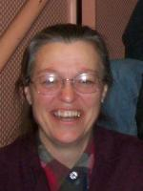












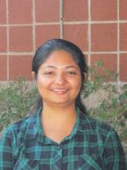
Acknowledgement
Trish
Alvin
Devin
Paul
Sagnik
Urmi
Valeria
Xiyu
Dr. Marna Nelson
BCB GSO
Akshay
Ashish
Avani
Pranav
Rebekah
Sharmistha
BCB Volunteers

Slide 4

Special Thanks
Levi Baber
Jennifer D Johnson
IT Support Staff

Slide 5
Download workshop material
Go to: https://tinyurl.com/bcb-py-2018

Slide 6
Contents
0. Introduction to Python
Writing first Python program: Str and other variables
Data structures: Lists, Sets, Dictionaries
Conditionals and Loops: if/else, for and while loops
Functions in Python
File Input/Output

Slide 7
Chapter 0
Prologue

Slide 8
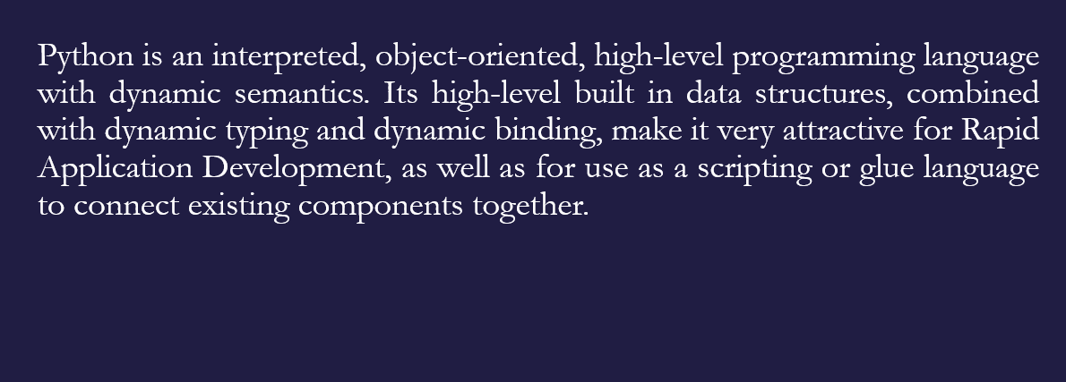
What is Python?
Ref: https://www.python.org/doc/essays/blurb/

Slide 9
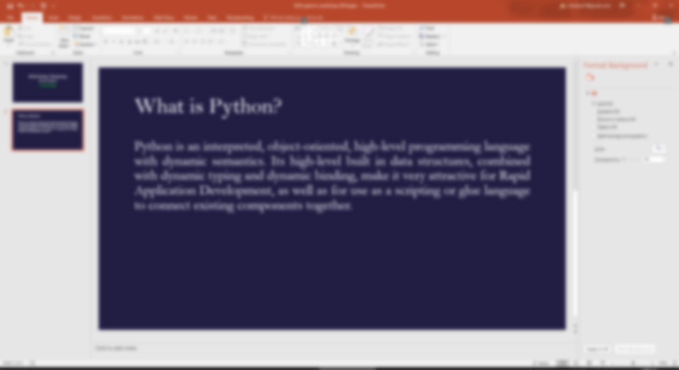

What is Python?

Slide 10


Brief history of Python
Guido van Rossum started developing his own language in 1989 Christmas holidays.
Named it Python after “Monty Python’s Flying Circus”
Q. To learn Python, do I have to like “Monty Python’s Flying Circus”
A. No, but it helps. :) [Ref: https://docs.python.org ]
Python was first used in the Amoeba project.
“In February 1991, after just over a year of development, I decided to post to USENET. The rest is in the Misc/HISTORY file.”
Python logo, 1990s–2005

Slide 11
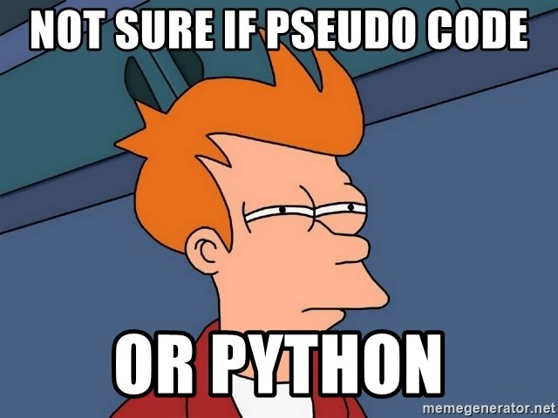
Why Python
Python is great for beginners
Python is high level language and easy to learn!
Python is versatile
Applications include data analysis, web development, game development
Python has great modules and libraries
PyPI “Python Package Index is a repository of software for the Python programming language. There are currently 132368 packages here.”
Python is supported by many platforms Linux/Windows/Mac
Python is growing rapidly. It is one of the 3 official languages at Google.

Slide 12
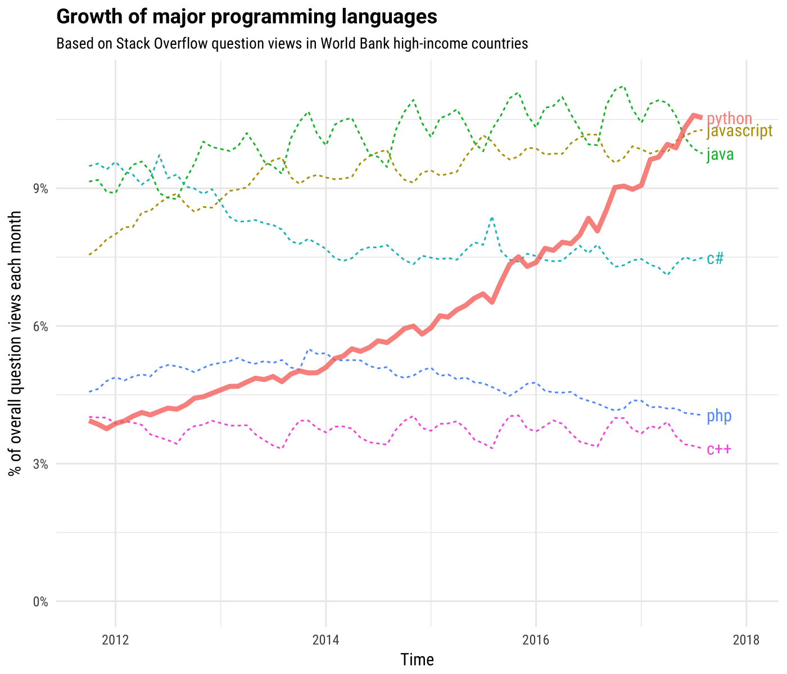
Ref: http://news.codecademy.com/why-learn-python/

Slide 13






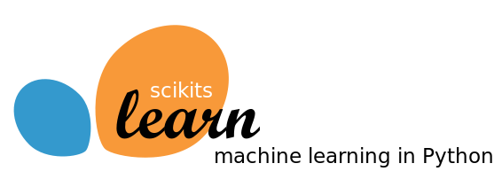


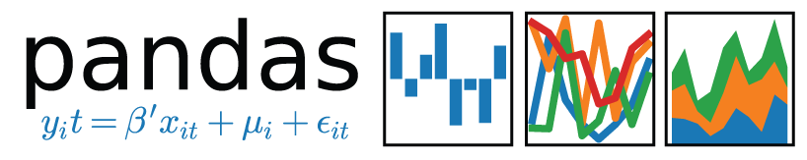

Few awesome examples of Python work

Slide 14
What is Python, seriously?
Python is free and open source high level, interpreted object oriented programming language
Free and open source: costs $0 and you can see the python source code
High level: closer to humans than to machine, easy to write and read
Interpreted: executes directly and freely without compiling
Object oriented: programming paradigm that models data into classes and objects
Programming language: language used to interact with computers

Slide 15
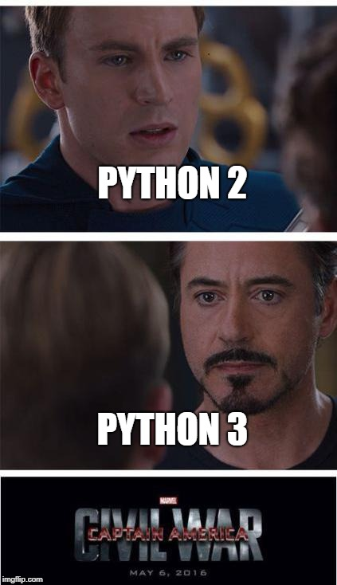
Getting Started
Downloading Python is free
Python comes preinstalled in most linux distros
https://www.python.org/downloads/
Python 2 vs Python 3
Python 2.x is legacy, Python 3.x is the present and future of the language
Python 3.x is not backwards compatible with Python 2.x
As of now, Python 2.x has more library support and is used more
For a beginner, Python 2.x vs Python 3.x shouldn’t matter

Slide 16
Setting up Python 2.7.x
Windows User
Go to Start -> Search “IDLE(Python GUI)”
If you don’t’ have it, Open Software Center
Search for “Python” and install Python 2.7.x
Go to Start → IDLE(Python GUI)
If working on personal laptop/computer (Windows)
Download and install python for windows: https://www.python.org/downloads/
Go to Start → IDLE(Python GUI)
For linux and mac users
Open Terminal and type “python”

Slide 17
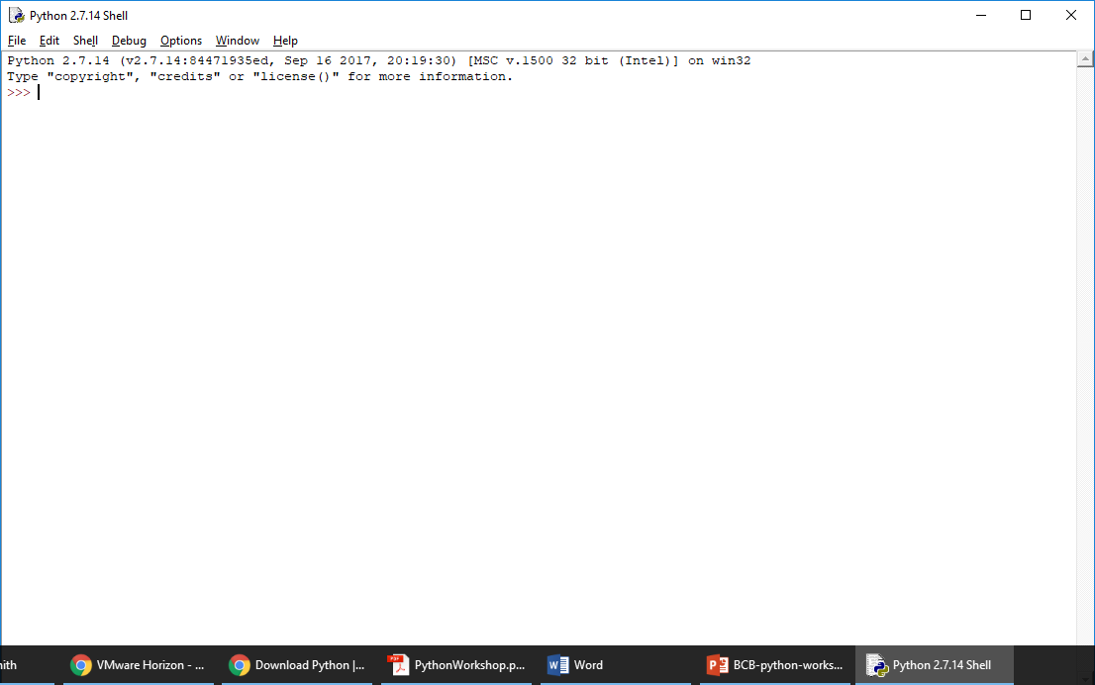
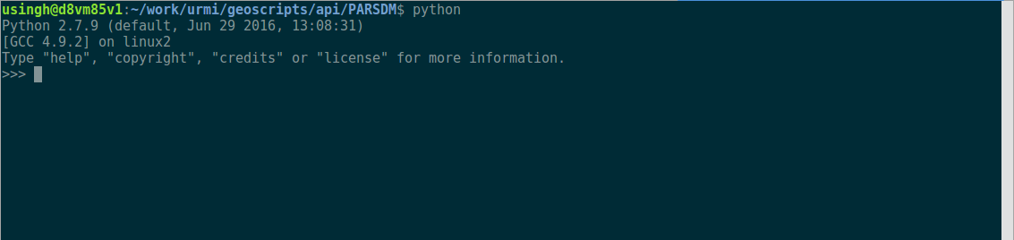
Congratulations! you’re ready to code in Python

Slide 18
Chapter I
First Python Program

Slide 19
Printing text
Windows users
In Python Shell go to “File” → “New File”
Linux and Mac users
Use any text editor (gedit, TextEdit, Vim, nano etc.) and create a new file
In the new file write
print “OK Computer”
Save file as “myfirst.py”
Windows users: Go to “Run” → “Run Module” or press F5 key.
Linux and Mac: On terminal type python myfirst.py and enter

Slide 20
Comments in Python
A single line comment in python starts with “#” character
Multiline comments start and ends with ‘’’ (3 single quotes) or “”” (3 double quotes).
Now add comments to “myfirst.py” before the print statement
# This is a single line comment
‘’’ This
is a
multiline
comment
‘’’
Did anything change after executing the code with comments?

Slide 21
Few more “print” examples python
“print” always prints in newline, use “print something” followed by a comma to print next print statement on same line
print “OK Computer”, OK Computer
print “OKNOTOK” OKNOTOK
print “OK Computer”,
print “OKNOTOK” OK Computer OKNOTOK
#Second Option
print “OK Computer”, “OKNOTOK”

Slide 22
Strings
“str” class in python defines string objects
Strings are enclosed by either double or single quotes
Multiline string can be defined using triple quotes
stringA=“A string in double quotes”
stringB=‘A string in single quotes’
stringC=‘’’A multiline
String in triple quotes’’’
Characters in a string can be accessed using [ ] operator
print stringA[0] A
Note: “stringA”, “stringB” and “stringC” are known as variables

Slide 23
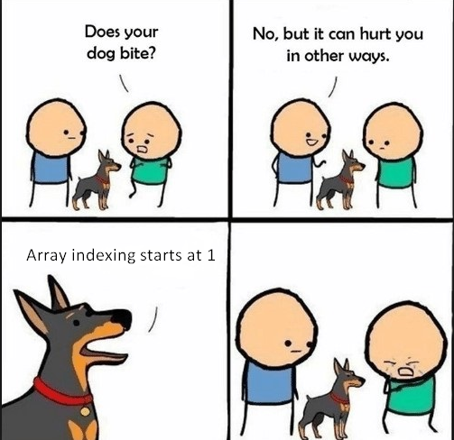
String slices
Slice syntax is easy way to refer to substrings in a string
stringD=“Blackstar”
print stringD[2:5] “ack”
print stringD[4:] “kstar”
print stringD[:-1] “Blacksta”
print stringD[-4:-1] “sta”
print stringD[::2] “Baktr” #Note the extended slice [start:stop:step]
print stringD[::-1] #reverses the string
B | l | a | c | k | s | t | a | r
0 | 1 | 2 | 3 | 4 | 5 | 6 | 7 | 8
-9 | -8 | -7 | -6 | -5 | -4 | -3 | -2 | -1

Slide 24
String methods
“str” class defines many handy methods for string operations
For complete list of methods https://docs.python.org/2/library/stdtypes.html#string-methods
Method | Description
str.capitalize() | Return a copy of the string with its first character capitalized and the rest lowercased.
str.count(sub[, start[, end]]) | Return the number of non-overlapping occurrences of substring sub in the range [start, end]. Optional arguments start and end are interpreted as in slice notation.
str.find(sub[, start[, end]]) | Return the lowest index in the string where substring sub is found within the slice s[start:end]. Optional arguments start and end are interpreted as in slice notation. Return -1 if sub is not found.
str.isdigit() | Return true if all characters in the string are digits and there is at least one character, false otherwise.
str.replace(old, new[, count]) | Return a copy of the string with all occurrences of substring old replaced by new. If the optional argument count is given, only the first count occurrences are replaced.

Slide 25
Built-in functions on strings
Calculate length of a string using “len()”
len() is a built-in function in python
print len(stringA)
print len(“OK Computer”)
Concatenate strings using “+” operator
print “OK” + str.capitalize(“computer”)
#same as below
print “OK” + “computer”.capitalize()
Can’t concatenate string and int type
print “Length of stringA”+len(stringA) #error
print “Length of stringA”+str(len(stringA))
print “Length of stringA”, len(stringA) #works!!!
Note str(len(stringA)) converts len(stringA) an int to string so that it can be concatenated with another string. This is known as typecasting.

Slide 26
Few examples on string operations
Open the file “strings.py” under the examples directory
Run the “strings.py” file and try to understand how if-else statements work.
Try to replace all the ‘t’s with ‘x’s and print your new string

Slide 27
Mutable vs immutable
Immutable: an object once defined can’t be changed e.g. stings
s=‘ABCD’
print s[1] #prints B
s[1]=‘E’ #gives error
s=‘GHI’
print s #prints GHI, string is mutated? NO.
Mutable: an object once defined can be mutated e.g. lists.

Slide 28
Variables in Python
Variables store information and are accessed/manipulated by the program. Variable names point to the memory locations where information is stored.
Different “types” of variables store different types of information e.g. str stores strings, int store integers, float stores real numbers etc.
In Python variable types are determined by the value referenced by that variable
var=“A string”
print type(var) <type 'str'>
var=2
print type(var) <type 'int'>

Slide 29
Python variable names
Can contain letters, numbers and underscores. Can’t start with a number.
Can’t be a reserved Python keyword
Reserved keywords have special meaning in python e.g. len is a function to get an object’s length
More reserved keywords:
and, as, assert, break, class, continue, def, del, elif, else, except, exec, finally, for, from, global, if, import, in, is, lambda, not, or, pass, print, raise, return, try, while, with, yield

Slide 30
Basic arithmetic operations
Let a=10 b=15 c=3.0
Operator | Description | Example | Output
+ Addition | Adds values on either side of the operator. | a+ b b + c | 25 18.0
- Subtraction | Subtracts right hand operand from left hand operand. | a - b b – c | -5 12.0
* Multiplication | Multiplies values on either side of the operator | a * b b * c | 150 45.0
/ Division | Divides left hand operand by right hand operand | b / a b / c b/float(a) or float(b)/a | 1 5.0 1.5
% Modulus | Divides left hand operand by right hand operand and returns remainder | b % a a % c | 5 1.0
** Exponent | Performs exponential (power) calculation on operators | a**b a**c | 1000000000000000 1000.0
// | Floor Division - The division of operands where the result is the quotient in which the digits after the decimal point are removed. | b//a b//c b//float(a) or float(b)//a | 1 5.0 1.0

Slide 31
You are ready for exercise 1 !!!
Go to folder exercises and open ex1.py
Read the questions and write your code in the space provided
Run your code when done
Estimated time to complete 15 mins

Slide 32
Chapter II
Data Structures in Python

Slide 33
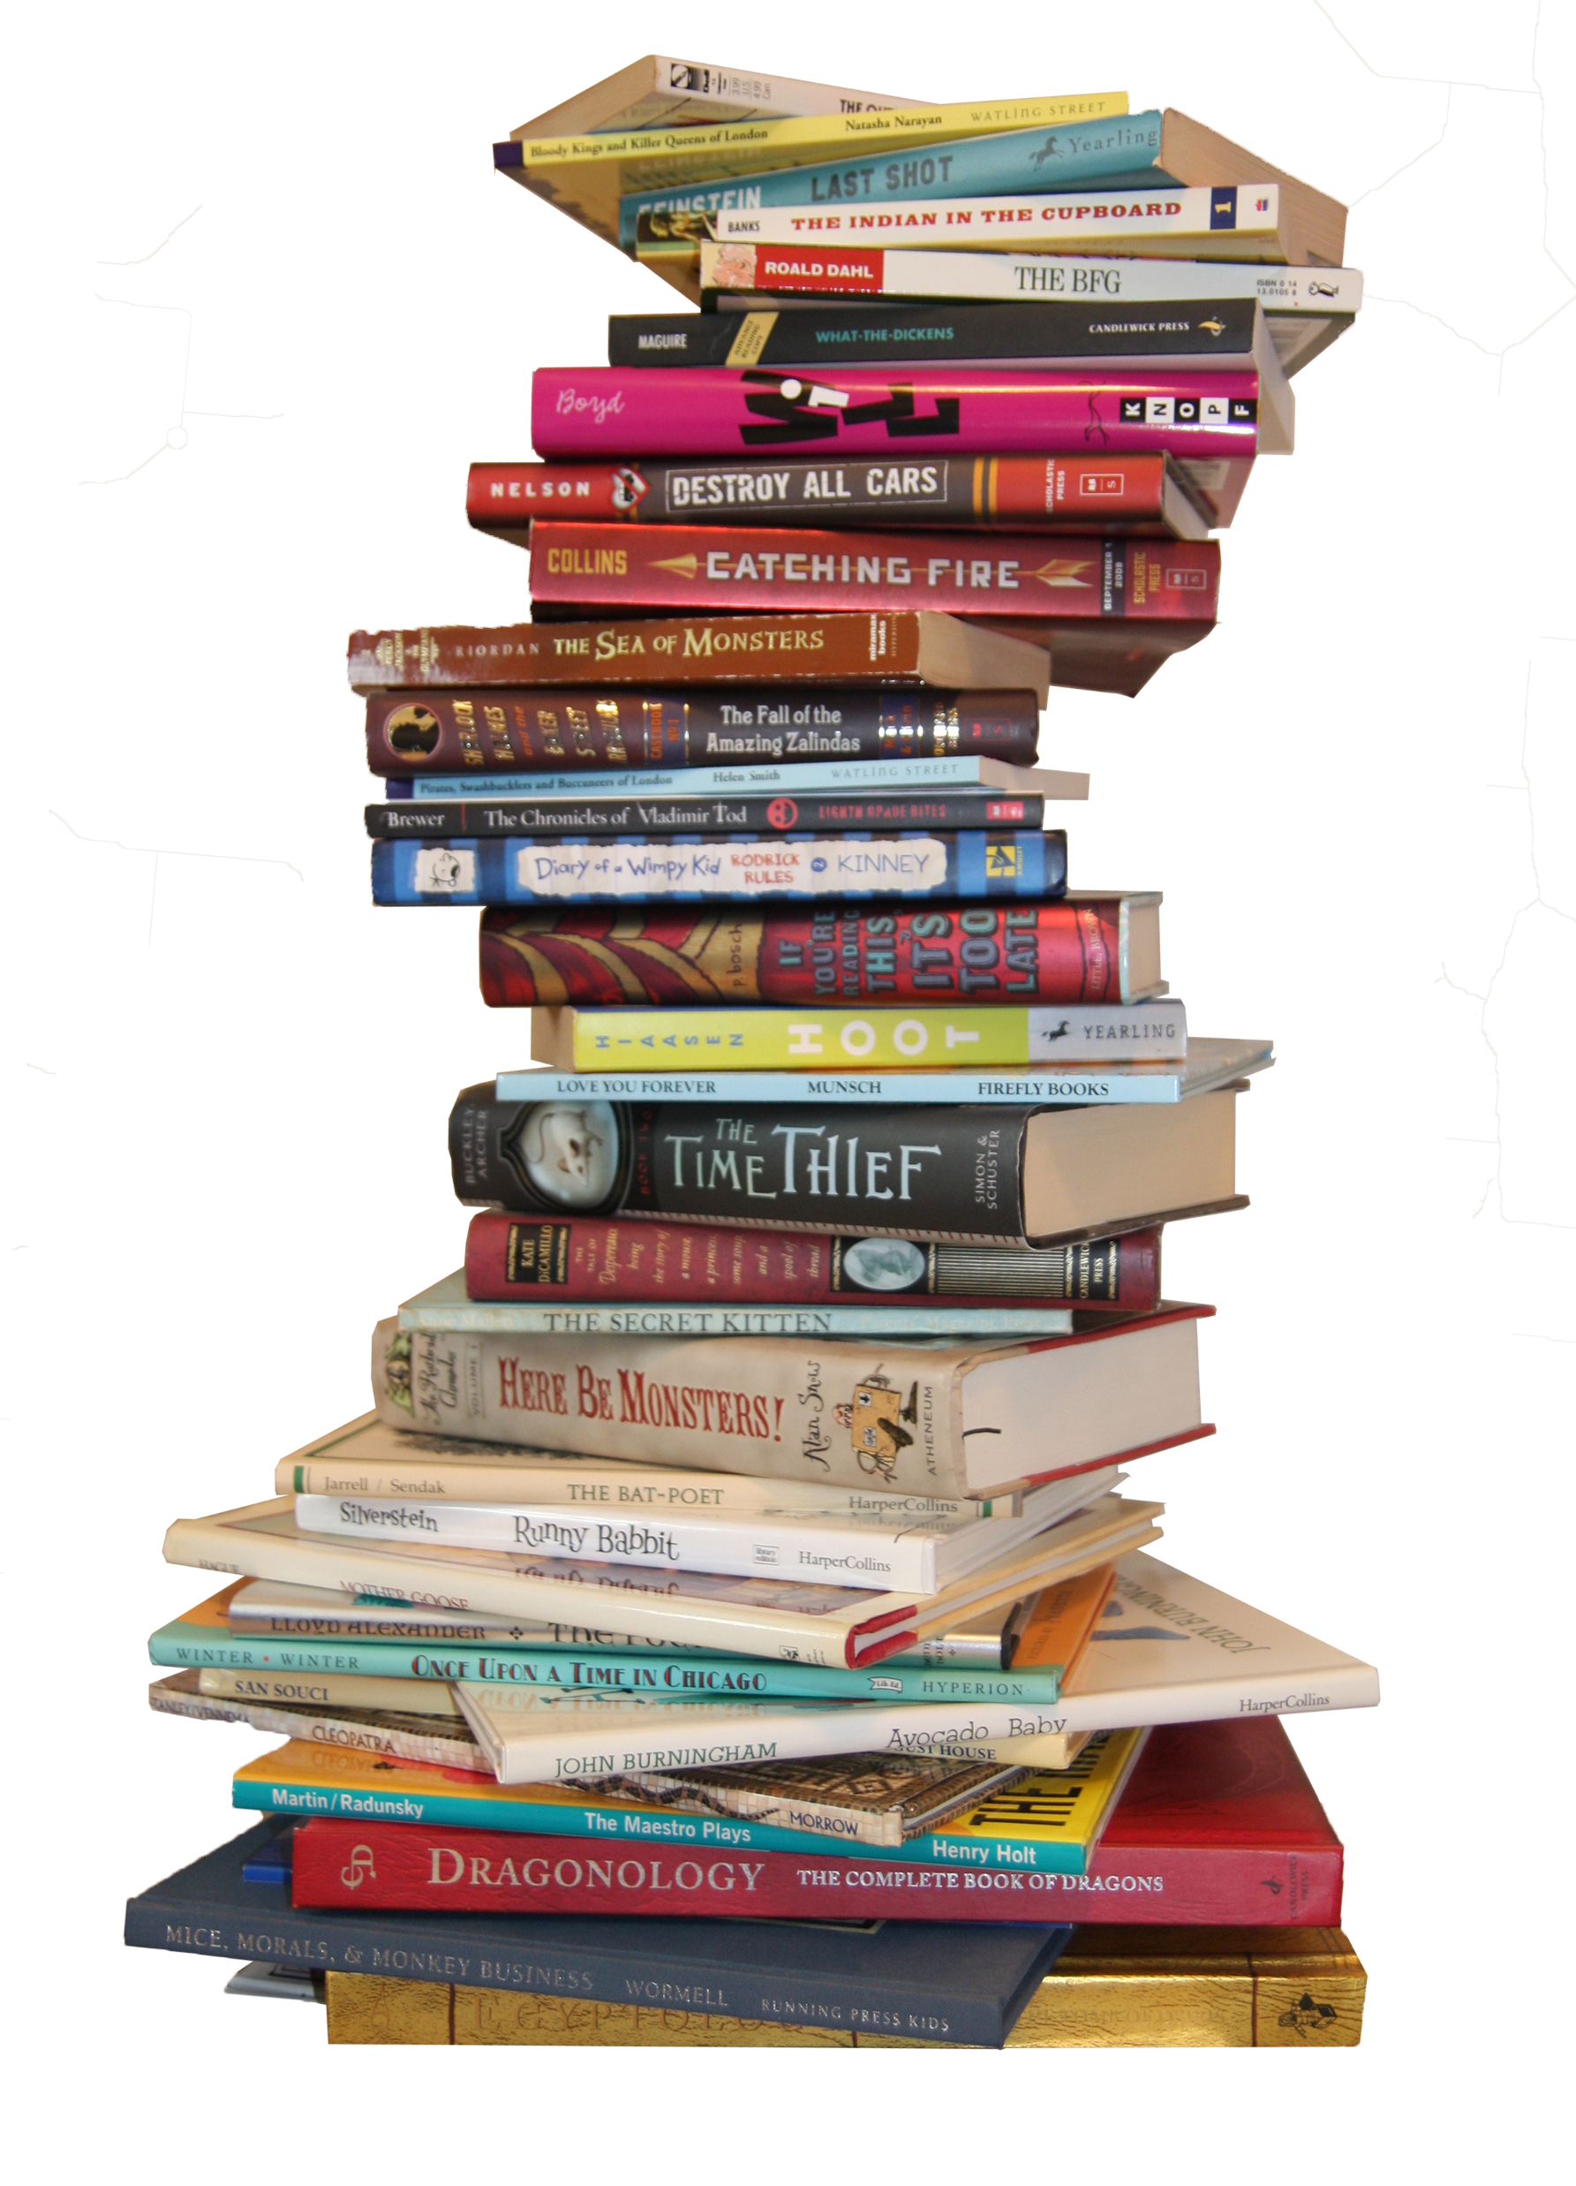
Data structures
Data structure defines a particular way of organizing, storing and accessing data
Lists: An ordered collection of objects
Sets: An unordered collection of “immutable objects”
Dictionaries: A mutable data structure that stores key, value pairs

Slide 34
Lists
Lists are defined with [ ] and work similarly to strings
flowers = [‘Orchid’, ’Carnation’, ’Sunflower’, ‘Marigold’]
print flowers[1] ‘Carnation’
print flowers[2:] [‘Sunflower’, ‘Marigold’]
print len(flowers) 4
print len(flowers[2]) 9
flowers.remove(‘Orchid’ )
flowers.append(564)
flowers.extend(['Roses','Tulips’]) #Adds content of list to flowers
flowers.extend(3.1415) #Error 3.1415 is not a list
print flowers ['Carnation', 'Sunflower', 'Marigold', 564, 'Roses’, 'Tulips']

Slide 35
Sets
Sets are defined using the built-in set function, set()
s=set() #creates empty set
s.add(1) #add to set
print s set([1])
s=set([1,2,3,4,5,1,2,6,7,2]) #creates set from give list
print s set([1, 2, 3, 4, 5, 6, 7])
s=set(‘Mississippi’)
print s set(['i', 'p', 's', 'M'])

Slide 36
Dictionaries
Dictionary (dict) can be defined by using { }
d = {} #empty dict
d[1]=‘value 1’
d[2]=‘value 2’
print d {1: 'value 1', 2: 'value 2’}
d = {1:’value1’,2:’value2’,3:’value3’}
print d[1] ‘value1’
print d[5] KeyError: 5
d['x']='valueNA’
print d {1: 'value1', 2: 'value2', 3: 'value3', 'x': 'valueNA'}

Slide 37
You are ready for exercise 2 !!!
Go to the folder exercises and open ex2.py
Read the questions and write your code in the space provided
Take a look at “data-structures.py” file under examples to see syntax
Run your code when done
Estimated time to complete 10 mins

Slide 38
Chapter III
Conditionals and Loops

Slide 39
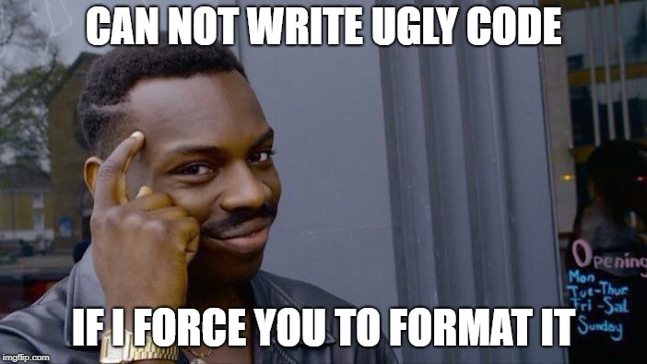

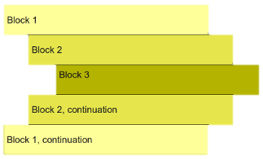
Indentation
Python uses indentation to define code blocks
A code block is a lexical structure of the source code
E.g. use for loop to repeat statement 10 times
i=0
for i in range(10):
print i #prints 0,1,2…9
print i #prints 9
Note the colon (:) and indentation after the for statement. All the statements having larger and equal margin from left are interpreted as a part of the for block.

Slide 40
If statements
If statements or the if/else statements are used to execute/skip a code block based on a condition
Basic syntax looks like
if(condition1):
planA()
else:
planB()
Can have multiple conditions
if(condition1):
planA()
elif(condition2):
planB()
else:
planC()
Can be without else
if(condition1):
planA()

Slide 41

Logical expressions
The conditions checked by if statements are called logical expressions
A logical expression can have a value “True” or “False” only
If value for a condition is “True”, the corresponding code block will get executed otherwise it will be skipped

Slide 42
Comparison operators
Operator | Description | Example expression | Output
== | Equals to | ‘str1’ == ‘str1’ | True
!= | Not equal to | ‘str1’ != ‘str1’ | False
> | Greater than | 3 > 3 | False
>= | Greater than or equal to | 3 >= 3 | True
< | Less than | 5 < 8 | True
<= | Less than or equal to | 5 <= 8 | True
is | Is the same object | x=[‘1’,’2’] y=[‘1’,’2’] x is y y=x x is y | False True
or | Boolean OR | 5<8 or 5>8 | True
and | Boolean AND | 5<8 and 5>8 | False
in | Membership test | ‘s’ in ‘books’ | True
not | Boolean NOT | not ‘s’ in ‘books’ | False

Slide 43
Few examples on if-else
Open the file “if-else.py” under the examples directory
Run the “if-else.py” file and try to understand how if-else statements work.
Make changes to the if-else conditions to allow the user to enter a power till 7 but limit the range of number from 0 till 5
Add an additional 4th option to let user find the reciprocal of the number e.g. reciprocal of 5 is 1/5 = 0.2. What will be the reciprocal if user enters 0 ?? Can you handle this exception using an if-else statement

Slide 44
For Loop
A loop is a structure which allows execution of a code block repeatedly until a terminating criteria is reached.
For loop: repeat a block of code fixed number of times
Requires starting and ending criteria
for i in range(0,10):
print I
range() is an in-built function that will generate a list of numbers. E.g. range(0,3) will generate [0,1,2] and so will range(3). range(1,10,3) will generate [1,4,7] last argument is the step.

Slide 45
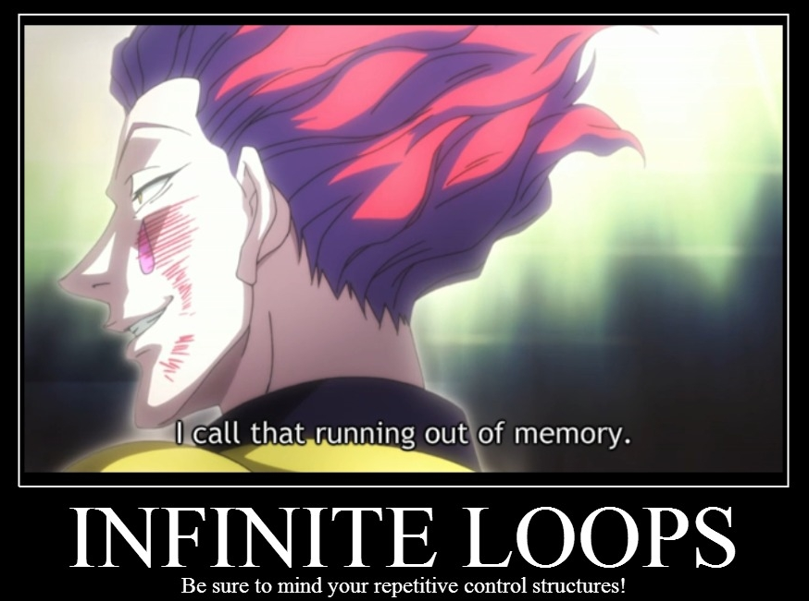
While loop
While loops run until a certain condition is satisfied
Requires a stopping criteria
x=0
while(x<10):
print x
x=x+1 #if x is not updated loop will never finish
Note: Python doesn't support x++ use x=x+1 or x+=1

Slide 46
Break and continue
break and continue are special statements. break is used to break out of the loop and continue is used to skip code block and return to for or while statement and start over.
mylist = [1,2,3,4,5,6,7,8]
for i in l:
if (i % 2==0): #skips any even number
continue
if (i == 7): #exits when i is equal to 7
break
print i prints 1,3,5

Slide 47
Few examples on loops
Open the file “loops.py” under the examples directory
Run the “loop.py” file and try to understand how for and while loop statements work.
Write a for or while loop that allows user to see the last n primes in the list. E.g. if input is 3 output should be 61, 67, 71.

Slide 48
Updating values inside loops
Often we need to change values inside a loop depending on the computational problem
Be careful to initialize variables before the loop
l=[‘abc’, ‘def’]
string=‘’ #important to initialize string to empty string
for x in l:
string= string+x
print string #prints abcdef. Note: ‘’.join(l) does same thing
Example finding sum on first n natural numbers
n=5
totalsum=0 #important to initialize totalsum =0
for x in range(n+1):
totalsum=totalsum+x #adds numbers 0 till 5
print totalsum #prints 15

Slide 49
You are ready for exercise 3 !!!
Go to the folder exercises and open ex3.py
Read the questions and write your code in the space provided
Run your code when done
Estimated time to complete 15-20 mins

Slide 50
Chapter IV
Functions

Slide 51
Functions
Functions are modules of code that perform a specific task
Functions promote reusability of code
E.g. Imagine if the built-in function “len()” was not defined. You would have to write your code every time you needed to get length of an object.
Functions make development easier by splitting a large complex program into smaller modules
Functions make it easier to detect bugs in the program

Slide 52
Functions in Python
Function in Python begins with “def” keyword followed by function name and parentheses.
The arguments the function takes are placed in the parentheses.
The function block starts after a “:”
“return” statement returns a value from the function. If “return” is absent the function returns “None”
def funcSum(a,b): #function name is funcSum, arguments are a and b
return a+b #returns a+b
print funcSum(5,2) #calls the function funcSum with a=5 and b=2 and prints 7

Slide 53
Few examples on functions
Open the file “functions.py” under the examples directory
Run the “functions.py” file and try to understand how functions work.
How many arguments each functions take ?
Write a function “getAge” which will ask for user’s age and print it.

Slide 54
Global and local scope
A variable with global scope can be accessed any where in the program
A variable with local scope is valid only in the code-block it is defined
a=10 #a has global scope
def func():
b=10 #b is local to func
a=5 #a is local to func
print b #prints b=10
print a #prints a=5, local scope
func()
print a #prints a=10
print b #error b is not defined, its scope ended with the function

Slide 55
You are ready for exercise 4 !!!
Go to the folder exercises and open ex4.py
Read the questions and write your code in the space provided
Run your code when done
Estimated time to complete 10-15 mins

Slide 56
Chapter V
Input/Output

Slide 57
Reading files in Python
Data is usually stored in plain text files and to process/analyze data we need to first read it in our program
Python provides a very good support via built-in functions to do file operations
“open(‘filename’, ‘mode’)” function opens the file
Filename is the name of the file to open, mode is one of the following mode
‘r’: Read only mode
‘w’: Write only mode
‘a’: Append mode
‘r+’: Read and write both.
Use close() functions to close the file when done.

Slide 58
Simple example (easy way)
with open(‘filepath/datafile.txt’) as f: #f is a File object
data=f.read().splitlines() #read file line-by-line
print data #now file is in the list data
print len(data) #print total number of lines
“with” allows for simpler syntax and make sure file is closed after reading is done. No need to use close()
f.write() writes to file when opened in ‘w’, ‘a’ or ‘r+’ mode
Note: Make sure to convert data from typr “str” to int or float

Slide 59
Few examples on reading files
Open the file “readfile.py” under the examples directory
Run the “readfile.py” file and try to understand how it works.
What happens if you use readlines() instead of read().splitlines() ?

Slide 60
You are ready for exercise 5 !!!
Go to the folder exercises and open ex5.py
Read the questions and write your code in the space provided
Run your code when done
Estimated time to complete 15-20 mins

Slide 61
Epilogue

Slide 62
What you have learned
Writing programs in Python
Basics of Python object type i.e. str, int, float, Boolean
Three data structures Lists, Sets, Dicts
If/else and loops
Defining functions
Reading data from files

Slide 63
What’s next …
Try out these really awesome (free) sources of python knowledge
Google's Python Class: https://developers.google.com/edu/python/
The Python Tutorial: https://docs.python.org/3/tutorial/index.html
You can access all the workshop material at https://github.com/urmi-21/BCB-python-workshop-2018
If you get stuck or need help, Google it! Or post your questions to stackoverflow.com only if you couldn’t find an answer
Always write comments in you code to make it more readable
Once again array indexing starts from zero !!!

Slide 64
That’s all Folks

